Slide 1
Customer Discovery 9

Slide 2
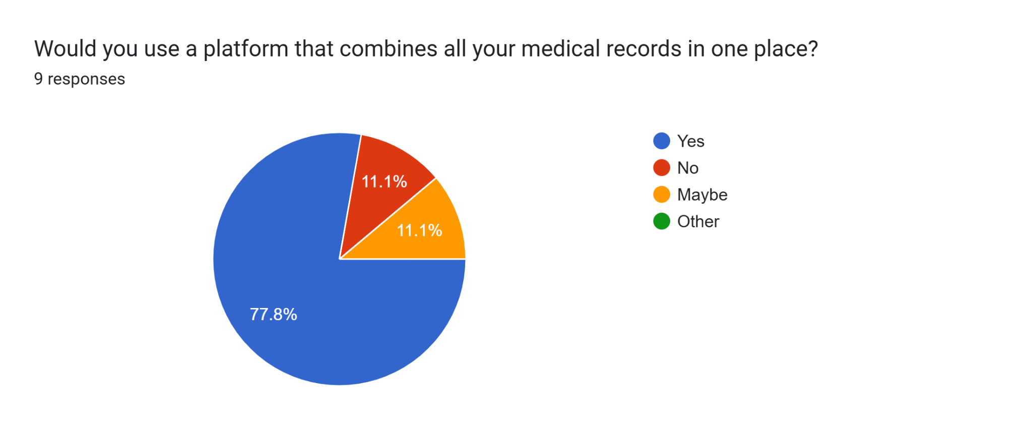

Slide 3
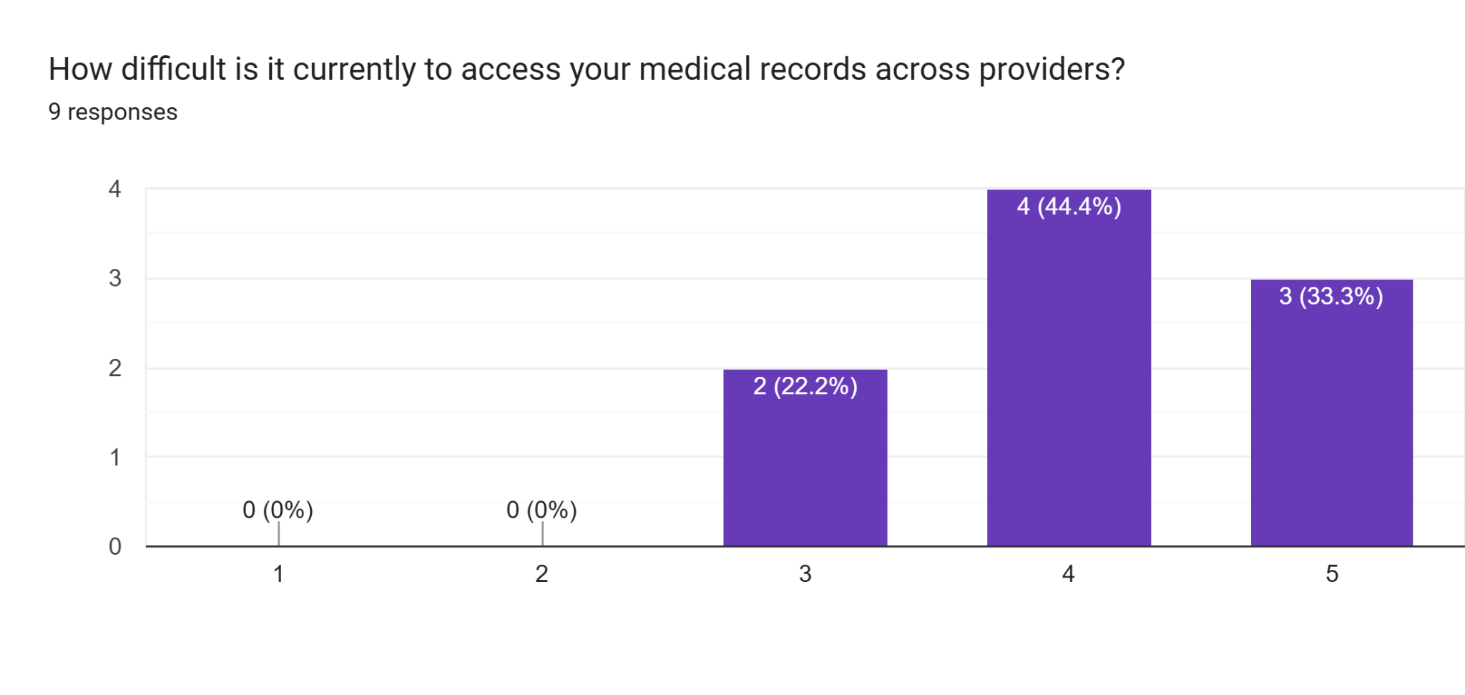

Slide 4
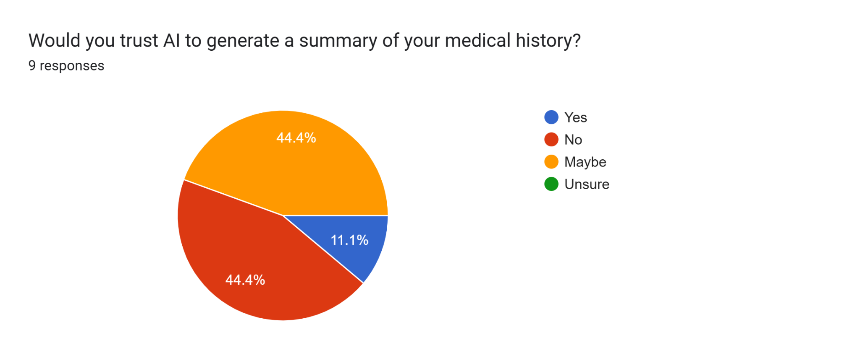

Slide 5
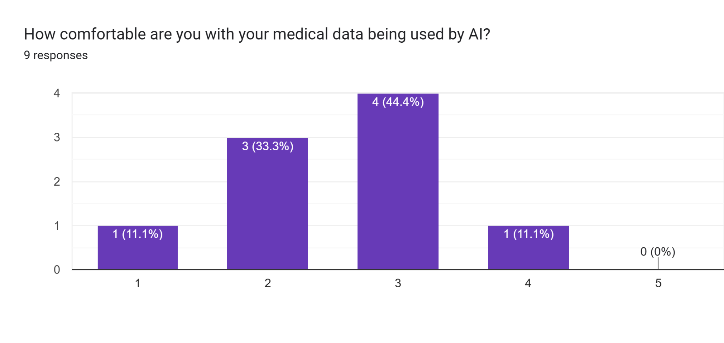

Slide 6
Product Description
Our platform securely aggregates your medical records across providers and uses AI to generate a clean, easy-to-read patient summary. This helps doctors make faster, more accurate decisions.

Slide 7
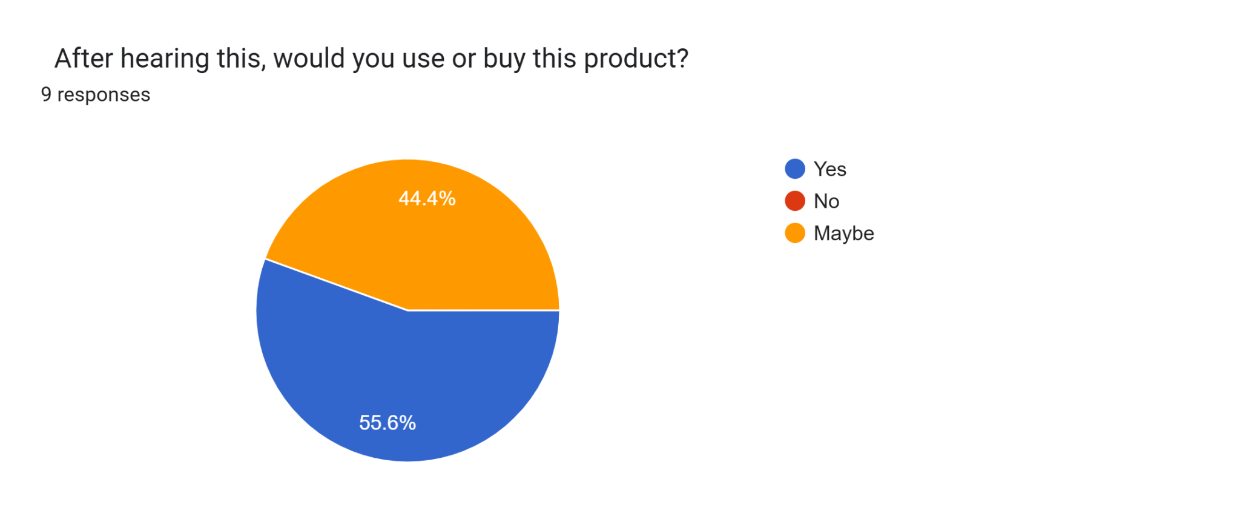

Slide 8
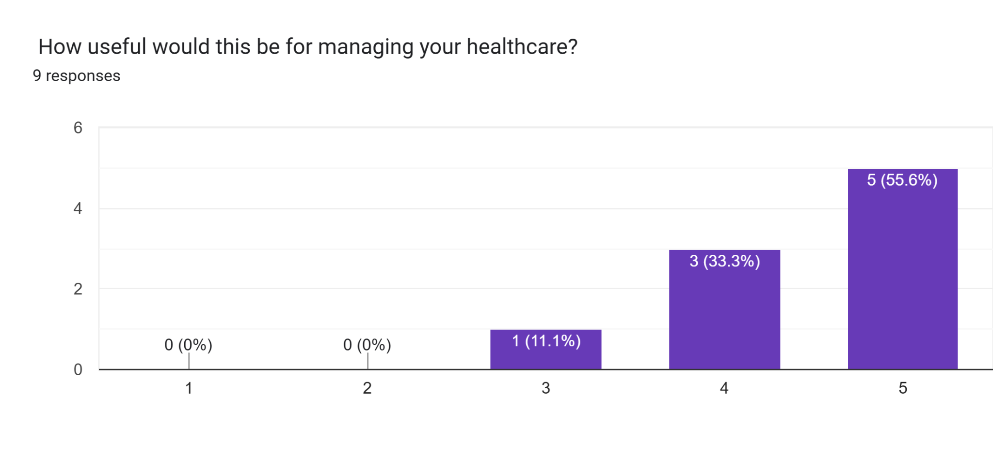

Slide 9
HIPAA Compliance
This platform is fully HIPAA-compliant and follows strict healthcare data privacy standards

Slide 10
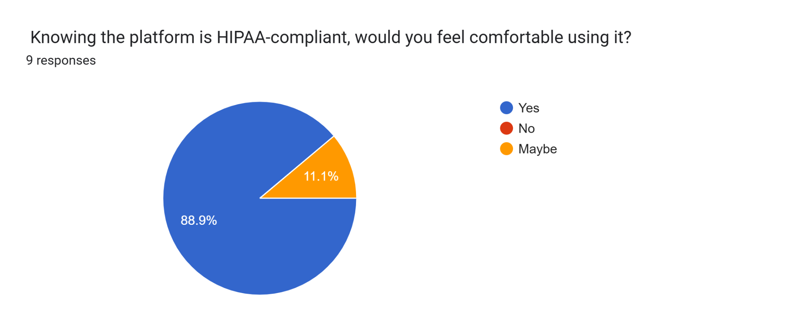

Slide 11
